Slide 1


Snowflake - Cloud
mintesnot

Slide 2
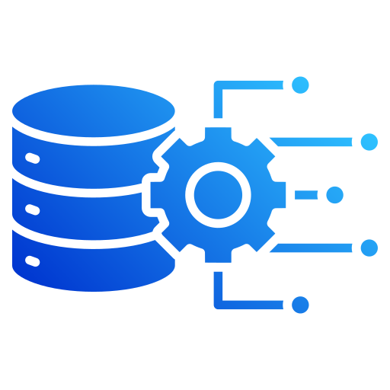
What is Snowflake?
Components of Cloud Data Platform
The Cloud Data Landscape
What is a Data Warehouse?
ETL
ELT
ETL Vs. ELT

Slide 3

What is Snowflake? ❄️
Snowflake is a cloud-native data platform that enables organizations to store, process, and analyze large volumes of data.
Unlike traditional data warehouses, Snowflake was built specifically for the cloud and provides virtually unlimited scalability, high performance, and simplified management.
Common Use Cases
Data Warehousing
Business Intelligence (BI)
Data Engineering
Data Lakes
Data Science & Machine Learning
Data Sharing

Slide 4
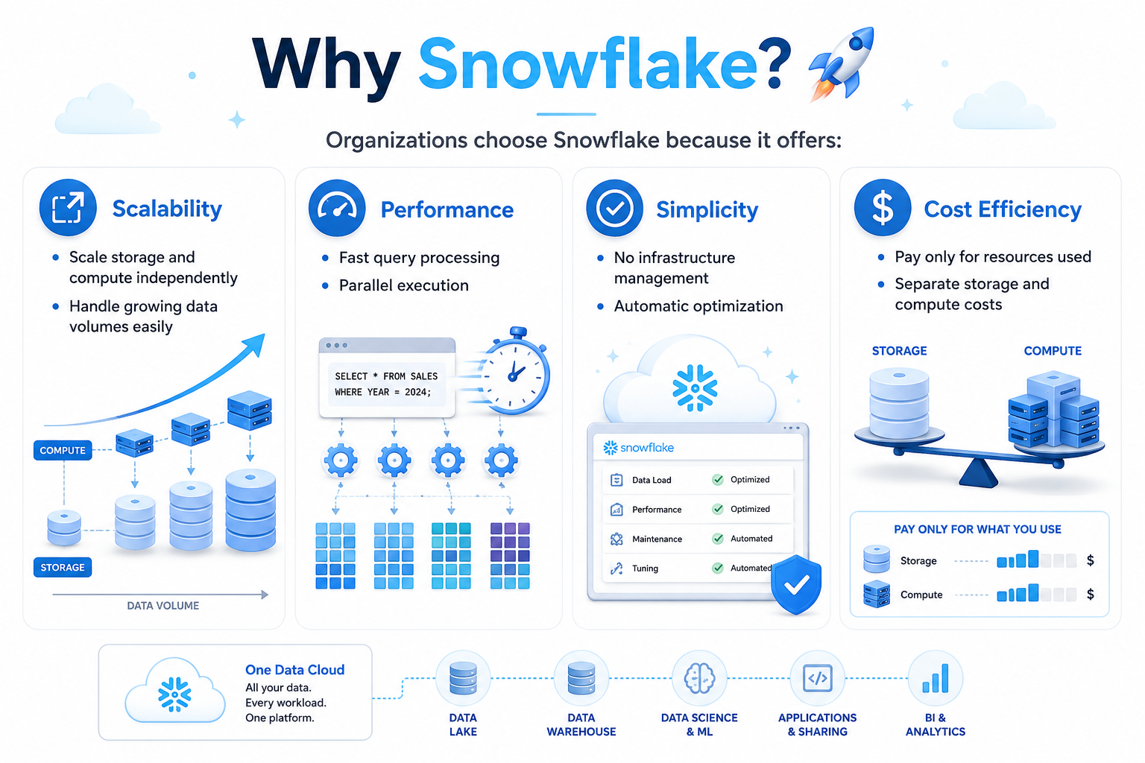

Why Snowflake?
Scalability
Scale storage and compute independently
Handle growing data volumes easily
Performance
Fast query processing
Parallel execution
Simplicity
No infrastructure management
Automatic optimization
Cost Efficiency
Pay only for resources used
Separate storage and compute costs

Slide 5
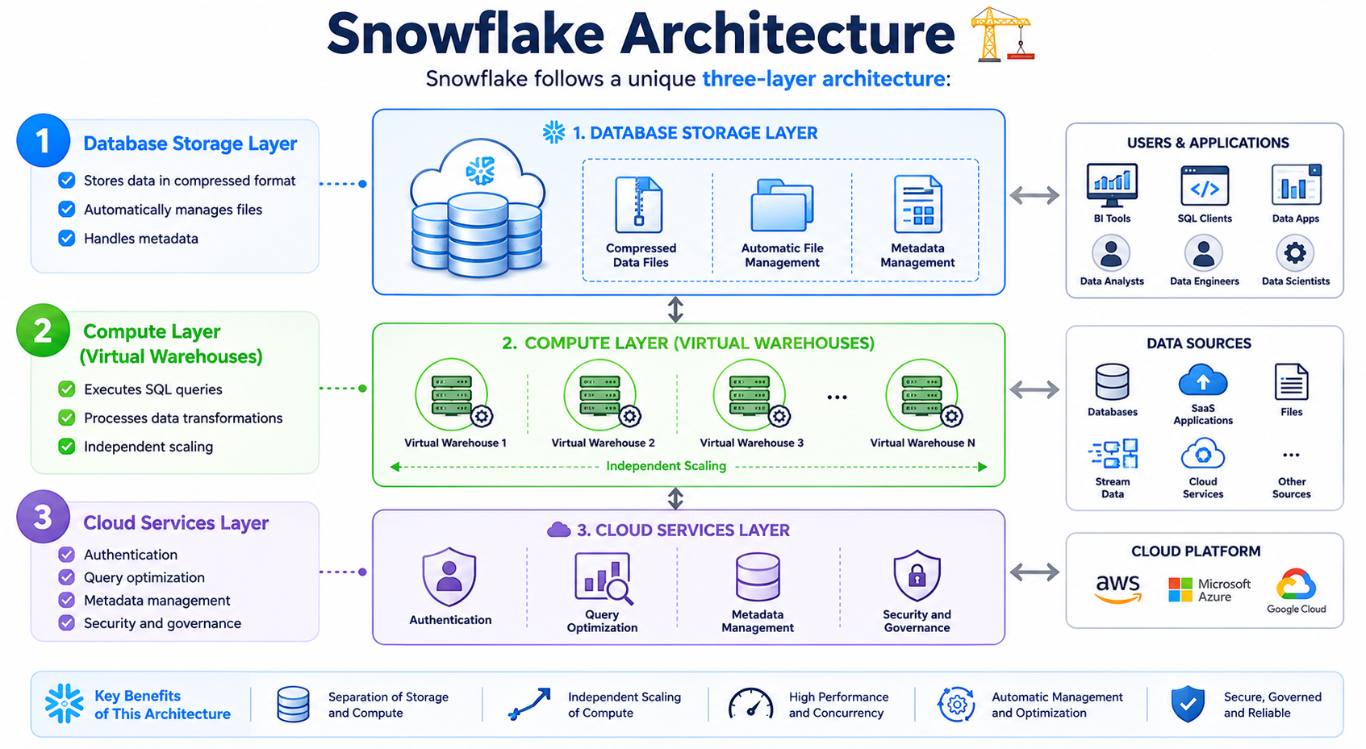
Snowflake Architecture 🏗️
Snowflake follows a unique three-layer architecture:
Database Storage Layer – Stores data in compressed format.
Compute Layer (Virtual Warehouses) – Executes SQL queries.
Cloud Services Layer - Authentication

Slide 6
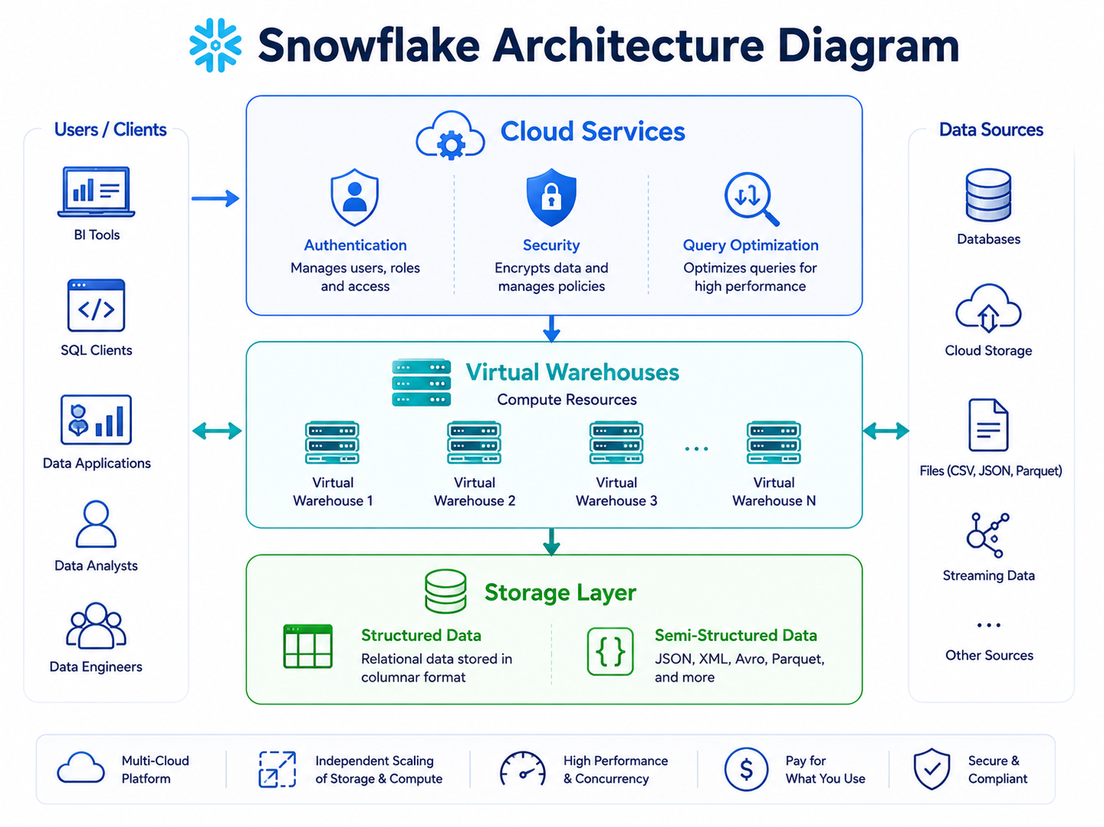
…

Slide 7
Snowflake Editions
Edition | Features
Standard | Basic analytics
Enterprise | Security & governance
Business Critical | Sensitive data
Virtual Private Snowflake (VPS) | Highest isolation

Slide 8
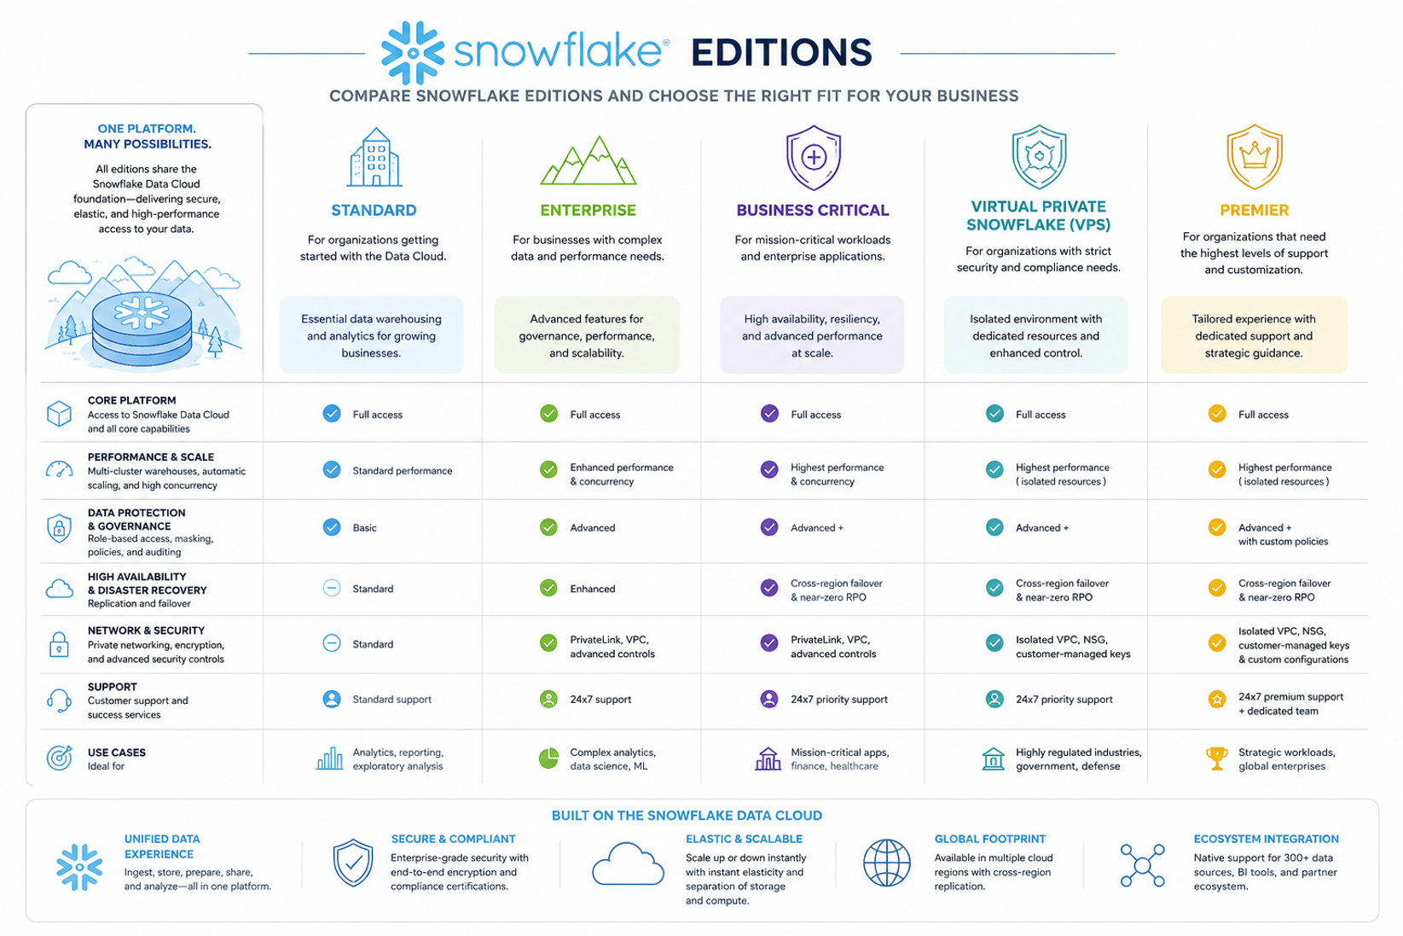
…

Slide 9
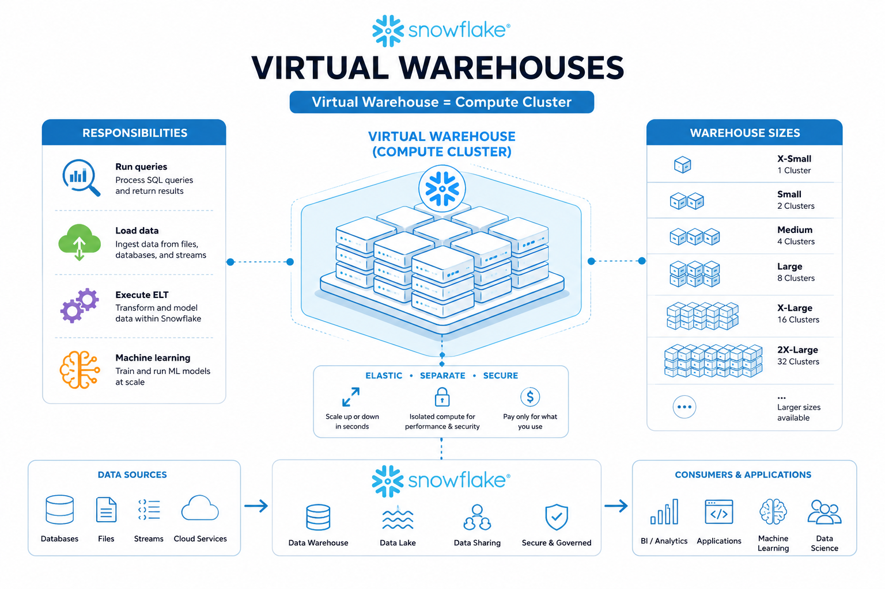
Virtual Warehouses
Virtual Warehouse = Compute Cluster
Responsibilities:
Run queries
Load data
Execute ELT
Machine learning
Warehouse Sizes
X-Small, Small, Medium, Large, X-Large, 2x-Large…

Slide 10
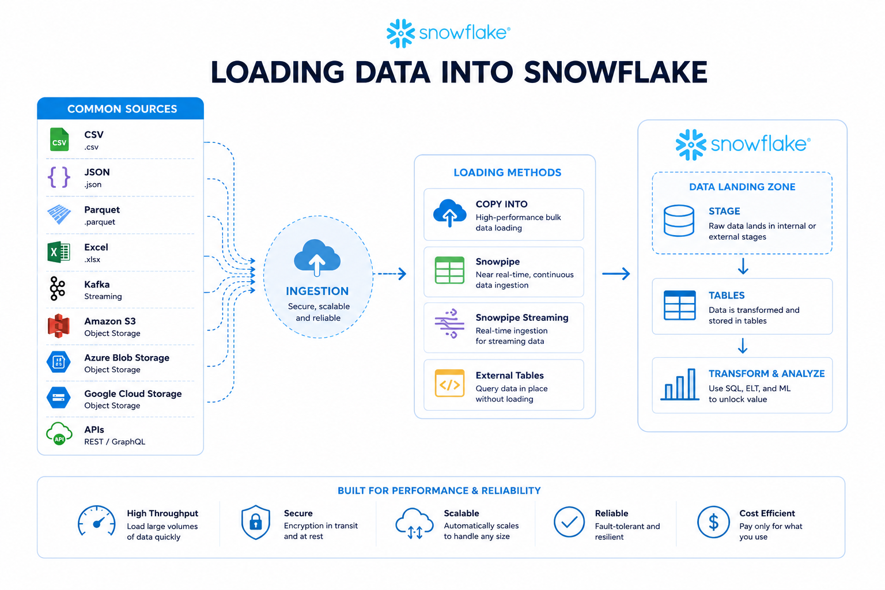

Loading Data into Snowflake
Common sources:
CSV
JSON
Parquet
Excel
Kafka
S3
Azure Blob
Google Cloud Storage
APIs

Slide 11
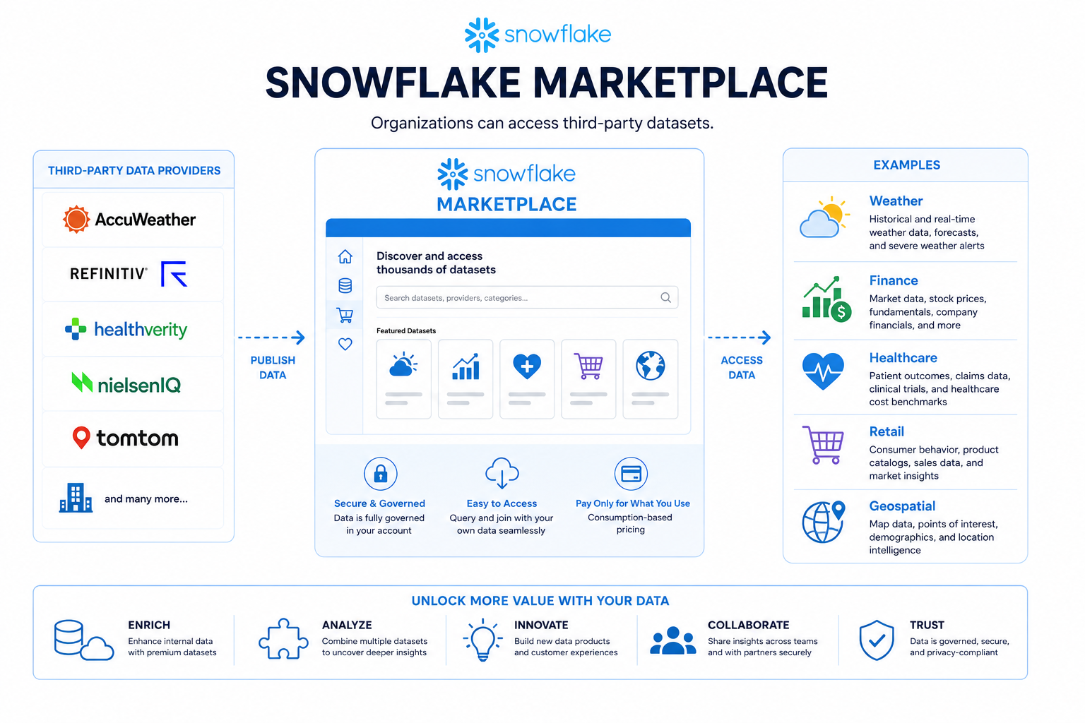
Snowflake Marketplace
Organizations can access third-party datasets.
Examples
Weather
Finance
Healthcare
Retail
Geospatial

Slide 12
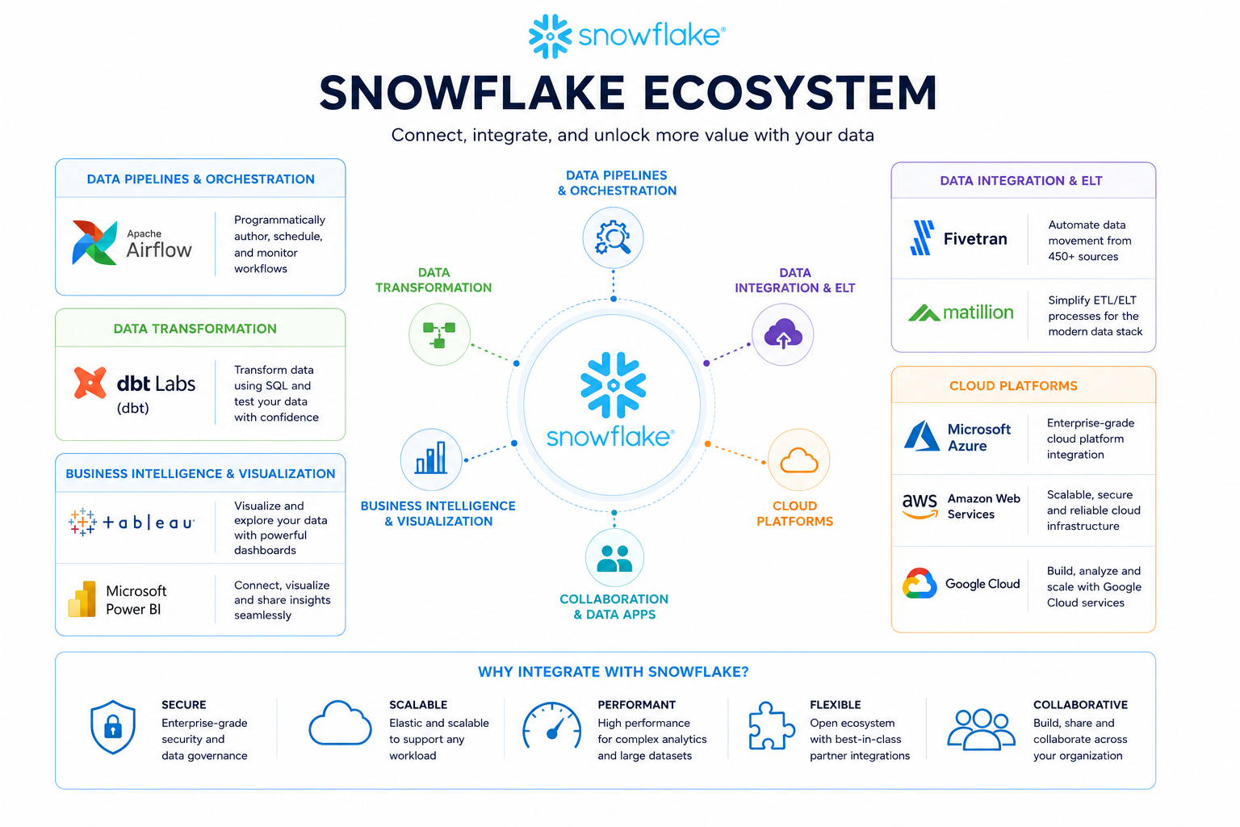

Snowflake Ecosystem
Common integrations:
Apache Airflow
dbt Labs (dbt)
Fivetran
Matillion
Tableau
Microsoft Power BI
Microsoft Azure
Amazon Web Services
Google Cloud

